Slide 1
Linux Pipes
EECS 338
Chris Fietkiewicz

Slide 2
The Plan
Pipe concepts
Programming a pipe

Slide 3
Pipe Concepts
Parent
fork()
Child
Kernel
READ
WRITE

Slide 4



Concept: File Descriptors
Process
0
2
1
Kernel
stdin stdout stderr

Slide 5


File Descriptors
Process
0
2
1
Kernel
stdin stdout stderr

Slide 6
Concept: Process Family
Parent
0
1
2
fork()
Child
0
1
2
stderr
stdout
stdin
Kernel

Slide 7
Concept: The Pipe
Parent
3 4
fork()
Child
3 4
Kernel
READ
WRITE

Slide 8
The Plan
Pipe concepts
Programming a pipe

Slide 9
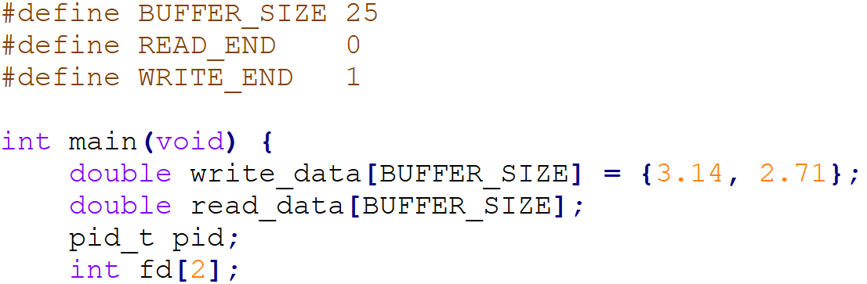
Program Setup

Slide 10
What you get
Parent
0
1
2
stderr
stdout
stdin
Kernel

Slide 11
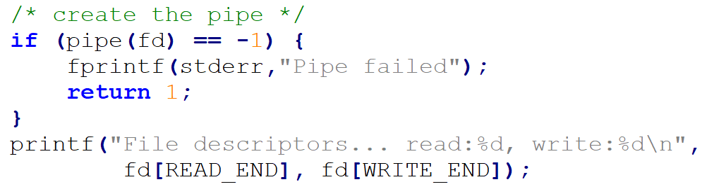
The “pipe” Function
fd
Parent
[0]
[1]
3
3 4
4
Kernel
READ
WRITE

Slide 12
File Descriptors
fd
Parent
[0]
[1]
3
3 4
4
Kernel
READ
WRITE

Slide 13

Chilren Inherit the Pipe
fd
Parent
[0]
[1]
3
3 4
4
fd
Child
[0]
[1]
3
3 4
4
Kernel
READ
WRITE

Slide 14
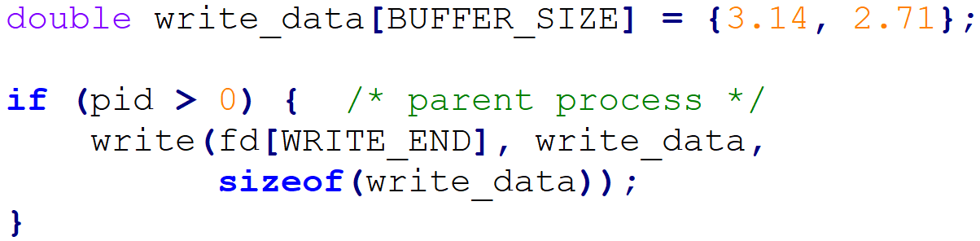
Writing To Pipe
fd
Parent
[0]
[1]
3
3 4
4
fd
Child
[0]
[1]
3
3 4
4
Kernel
READ
WRITE
3.14
2.71

Slide 15
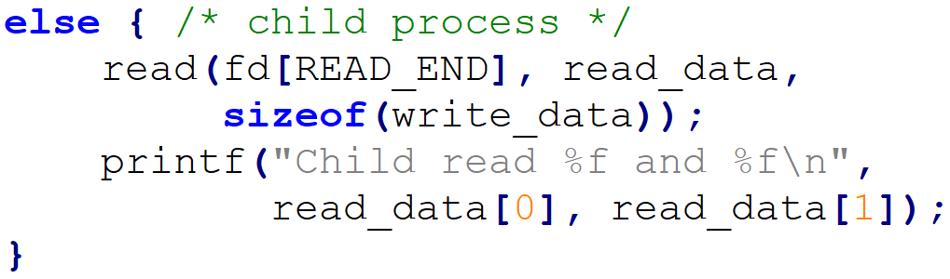
Reading From Pipe
fd
Parent
[0]
[1]
3
3 4
4
fd
Child
[0]
[1]
3
3 4
4
Kernel
READ
WRITE

Slide 16


Optional: Closing Pipes
fd
Parent
[0]
[1]
3
3 4
4
fd
Child
[0]
[1]
3
3 4
4
Kernel
READ
WRITE

Slide 17
The Plan
Pipe concepts
Programming a pipe

